Slide 1



MOVIE RECOMMENDER

Slide 2


what is recommender system & why we need it?
Table of contents
what is movie recommender?
Types
overview of project flow
Datasets
Examples of top movie recommender that already exists.

Slide 3



What is recommender system?
Recommender systems are the systems that are designed to recommend things to the user based on many different factors. These systems predict the most likely product that the users are most likely to purchase and are of interest to. Companies like Netflix, Amazon, etc. use recommender systems to help their users to identify the correct product or movies for them.

Slide 4

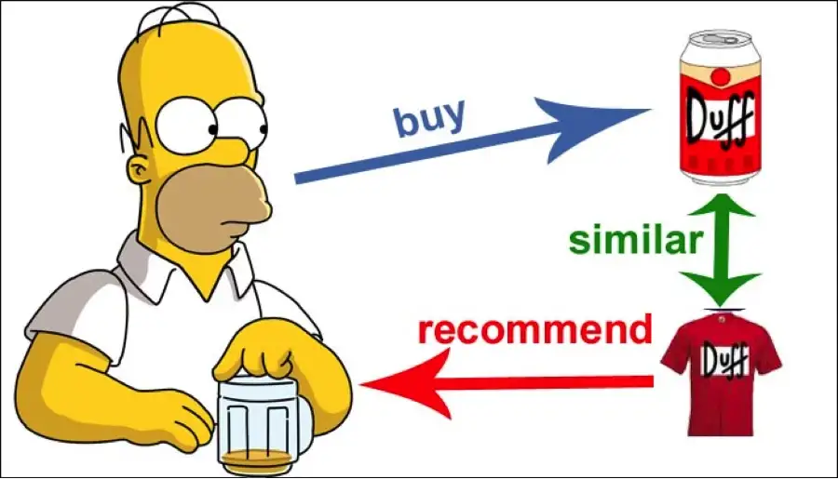

Why do we need a recommendation system?
Recommender system has the ability to predict whether a particular user would prefer an item or not based on the user's profile. Recommender systems are beneficial to both service providers and users [3]. They reduce transaction costs of finding and selecting items in an online shopping environment

Slide 5
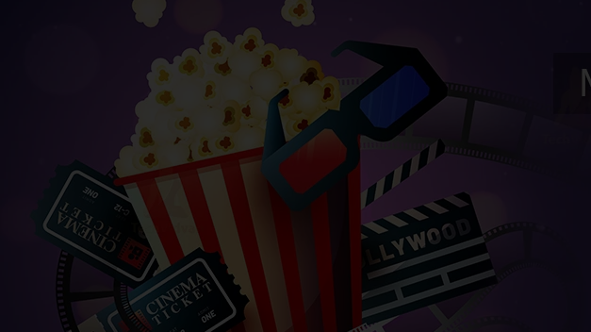
MOVIE RECOMMENDER SYSTEM
A movie recommendation system, or a movie recommender system, is an ML-based approach to filtering or predicting the users’ film preferences based on their past choices and behavior. It’s an advanced filtration mechanism that predicts the possible movie choices of the concerned user and their preferences towards a domain-specific item, aka movie.

Slide 6

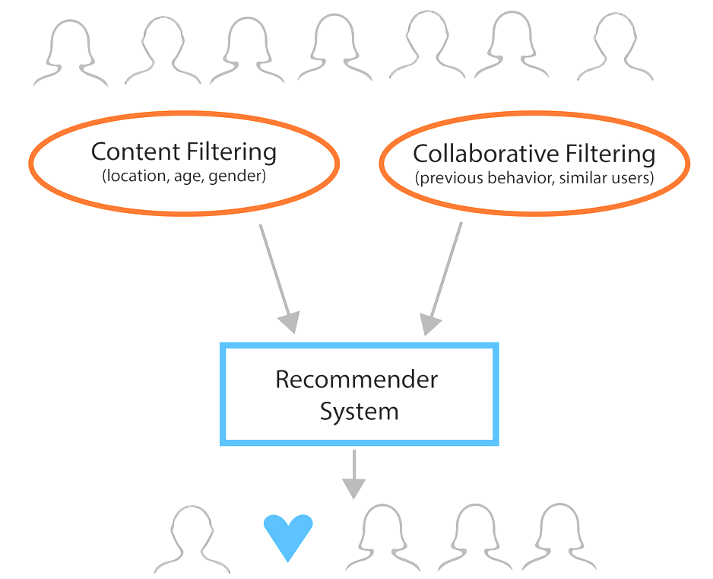

Types of movie recommender system
Movie recommendation systems use a set of different filtration strategies and algorithms to help users find the most relevant films. The most popular categories of the ML algorithms used for movie recommendations include content-based filtering and collaborative filtering systems.
01
Content-Based Filtering
02
Collaborative Filtering

Slide 7

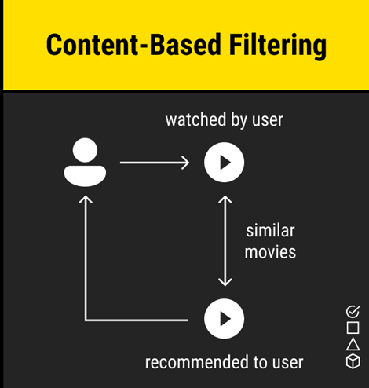
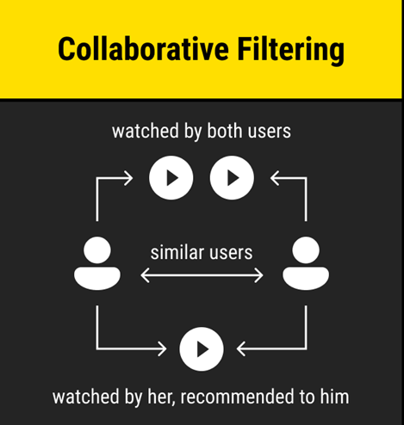

As the name suggests, this filtering strategy is based on the combination of the relevant user’s and other users’ behaviors. The system compares and contrasts these behaviors for the most optimal results. It’s a collaboration of the multiple users’ film preferences and behaviors. The core element in this movie recommendation system and the ML algorithm it’s built on is the history of all users in the database. Basically, collaborative filtering is based on the interaction of all users in the system with the items (movies).
A filtration strategy for movie recommendation systems, which uses the data provided about the items (movies). This data plays a crucial role here and is extracted from only one user. An ML algorithm used for this strategy recommends motion pictures that are similar to the user’s preferences in the past. Therefore, the similarity in content-based filtering is generated by the data about the past film selections and likes by only one user.

Slide 8

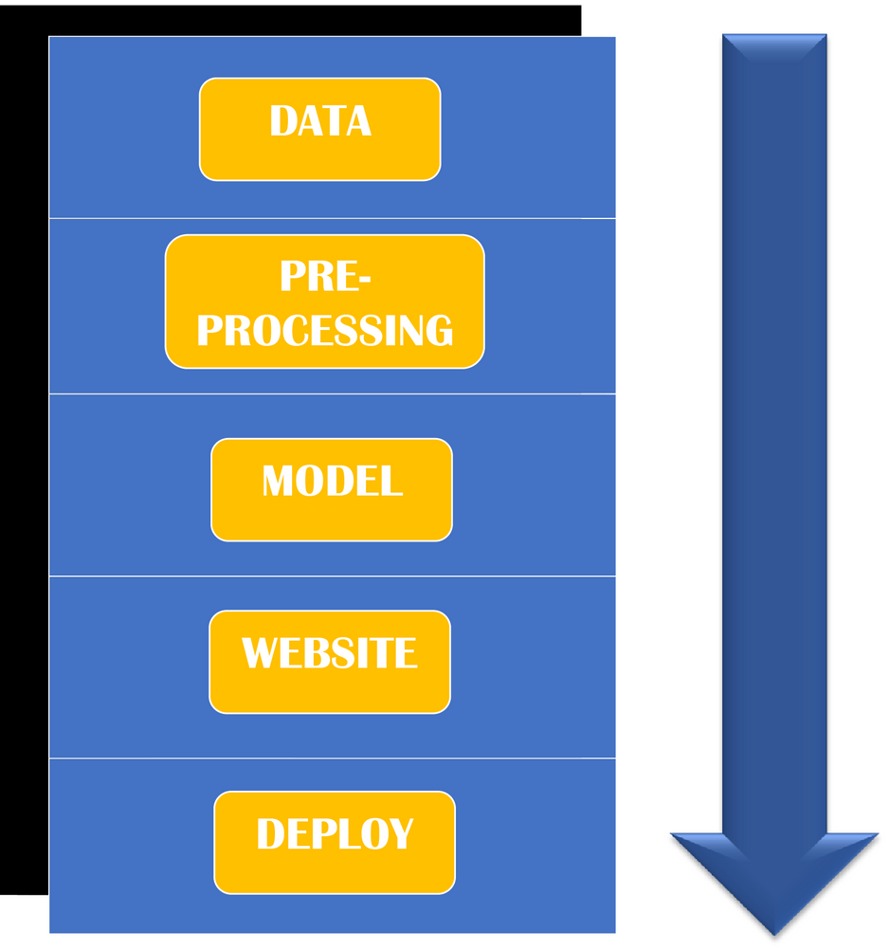
OVERVIEW OF PROJECT FLOW

Slide 9
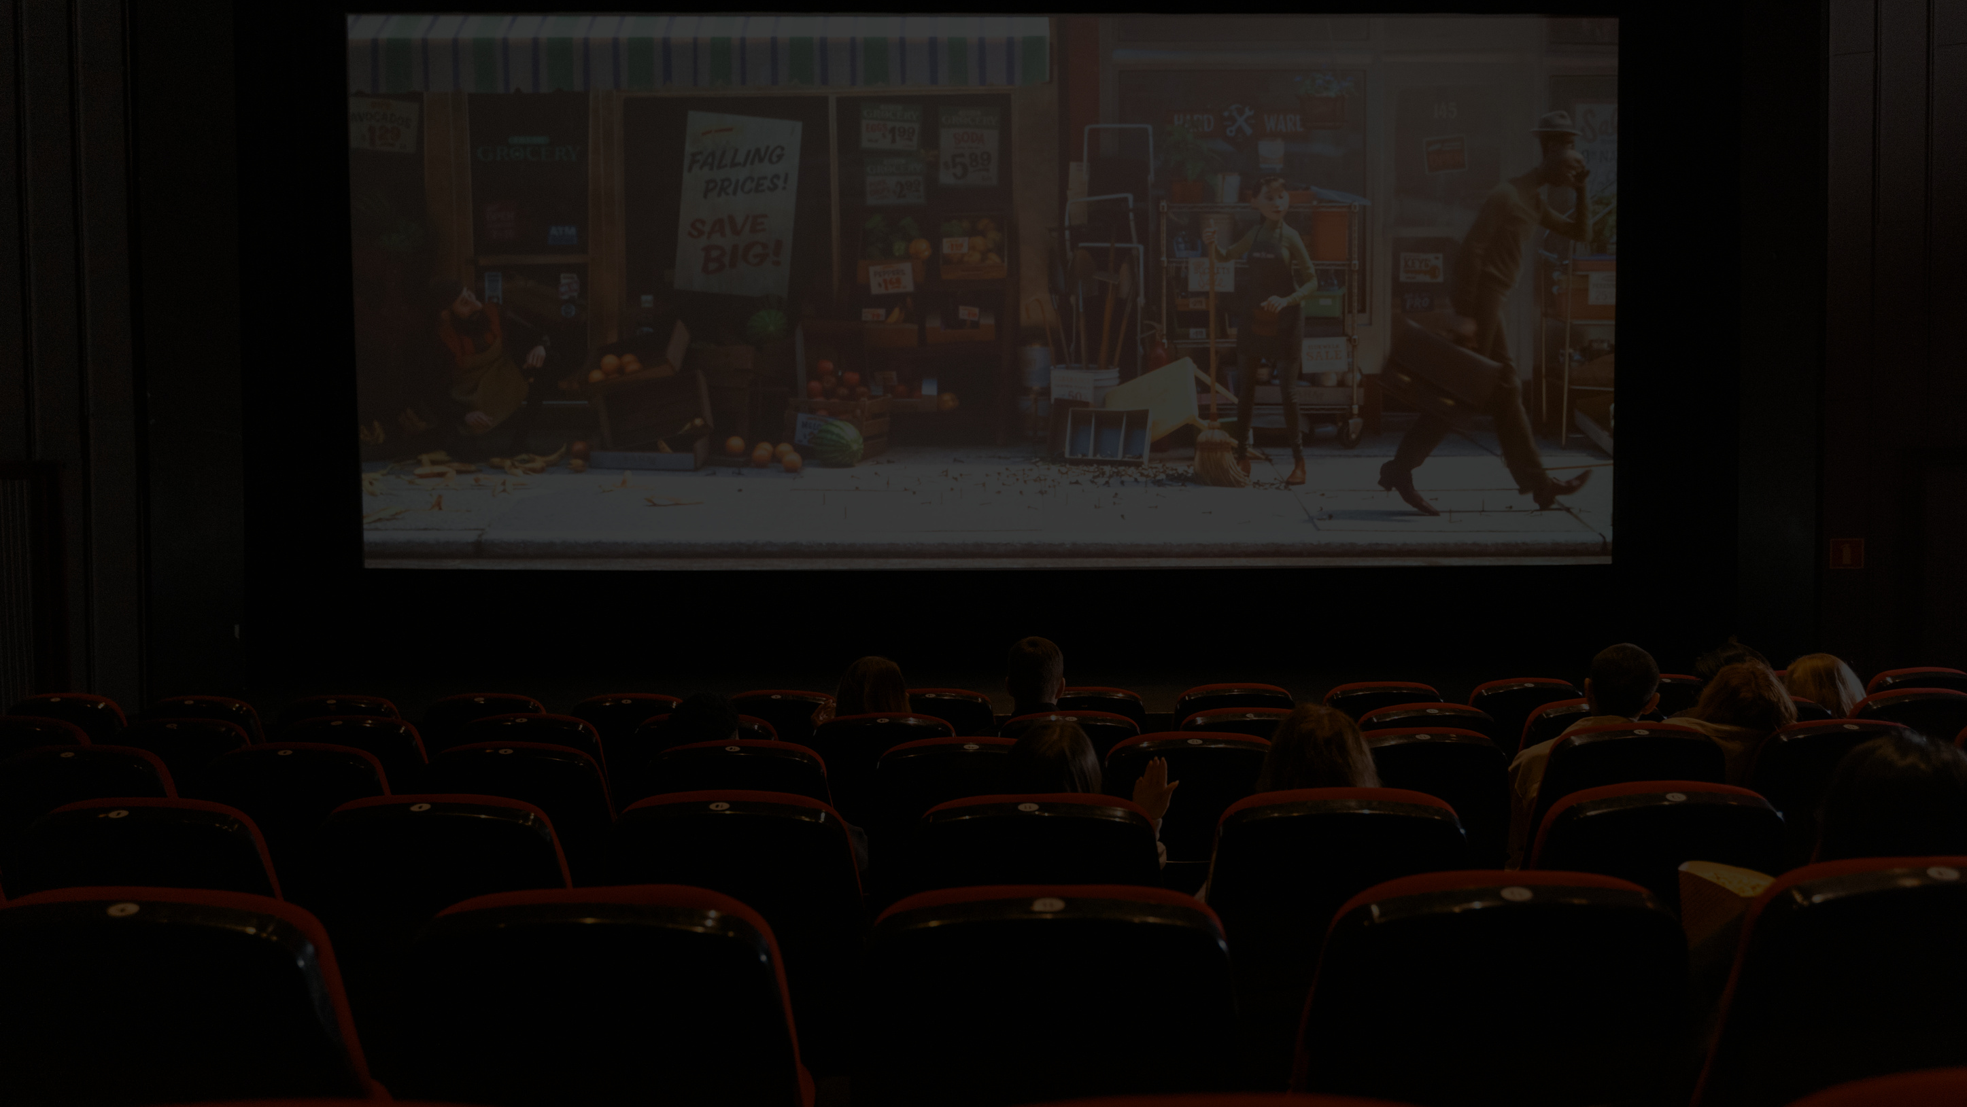


MOVIE DATASET
We have 2 datasets:(of 5000 movies)
· TMDB (the movie database) 5000 Movie datasets
We have data related to budget, genres, popularity, etc.
· TMDB 5000 credits datasets
We have data related to cast and crew.

Slide 10

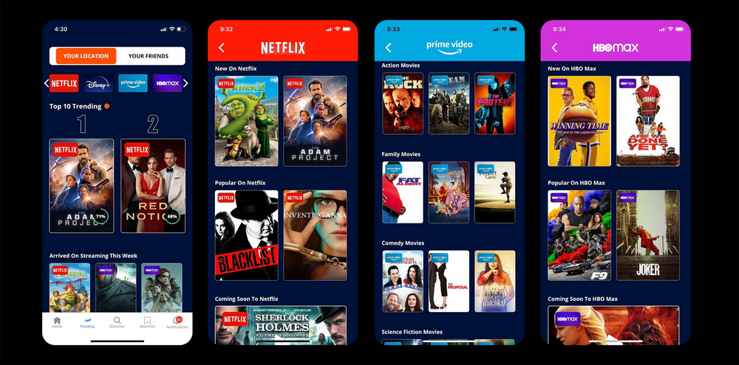
Top movie recommendation use cases
One can spot the increased use of the recommendation systems on almost every popular streaming service, social media, or e-commerce platform. These include Amazon, YouTube, Netflix, Facebook, to name a few. How do the recommendation systems help different industries provide more personalized experiences to their users? Let’s see how it works, based on the example of popular movie recommendation systems!

Slide 11


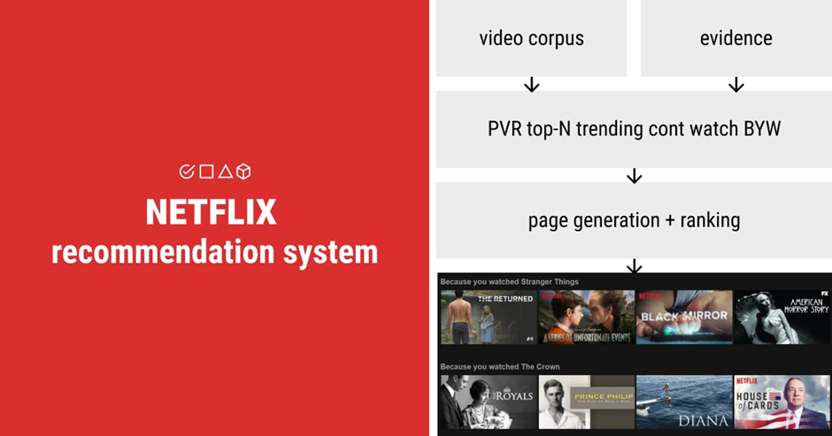
Some years back Netflix hosted a match for making the best recommender system, even rewarded in millions.

Slide 12


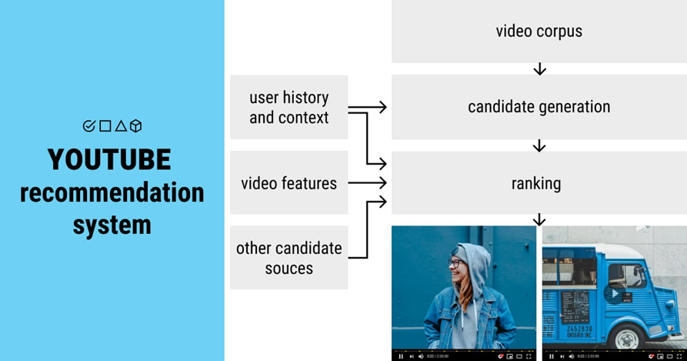
YouTube

Slide 13

References
https://labelyourdata.com/articles/movie-recommendation-with-machine-learning
https://www.mygreatlearning.com/blog/masterclass-on-movie-recommendation-system/
https://www.kaggle.com/code/rounakbanik/movie-recommender-systems
https://www.netflix.com/
https://www.youtube.com/
https://towardsdatascience.com/how-to-build-a-movie-recommendation-system-67e321339109

Slide 14



